Slide 1

PRESENTATION 3

Slide 2

XENON COMPILER
MEXICO CITY

Slide 3
Binary Operators:
For the third installment, Binary Operators were implemented,
such as:

Slide 4
Addition +
Subtraction -
Multiplication *
Division /

Slide 5
The necessary changes were implemented for the Lexer, the
Parser and the Code Generator

Slide 6

Lexer
The lexer now recognizes as valid the following tokens: “+”,”*”,”/”

Slide 7
So they can operate with the new implementations.

Slide 8

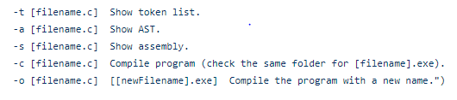
SWITCHES

Slide 9
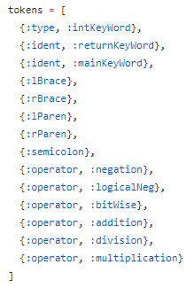
TOKENS

Slide 10
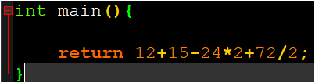
For the following source code

Slide 11
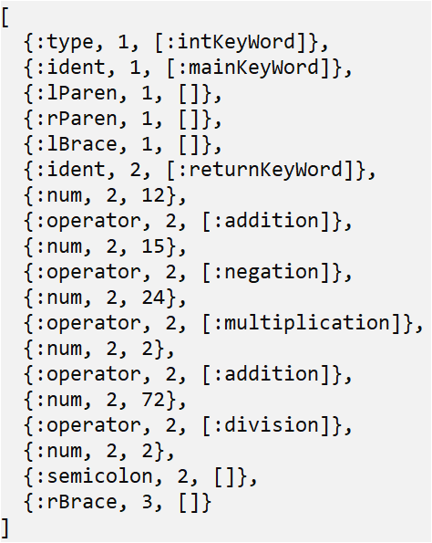
TOKEN LIST

Slide 12
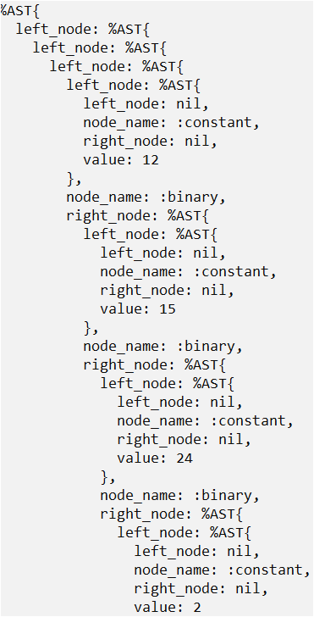
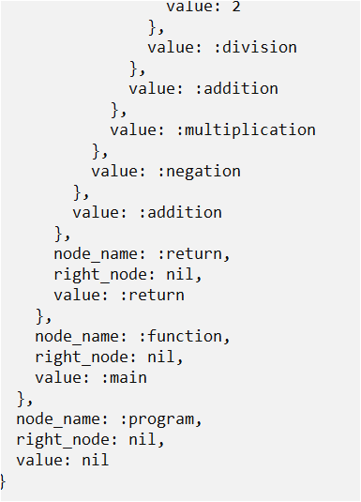
TREE

Slide 13
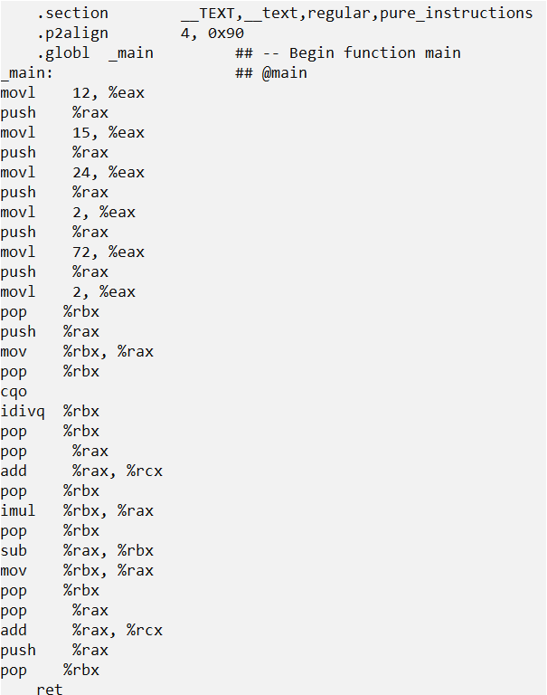
ASSEMBLY CODE

Slide 14
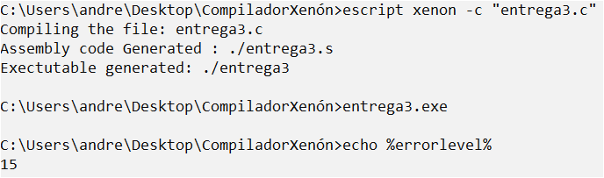
COMPILATION

Slide 15









Some of our tests
To fail
To pass

Slide 16
THANKS

